Slide 1
Creating a Static Module

Slide 2
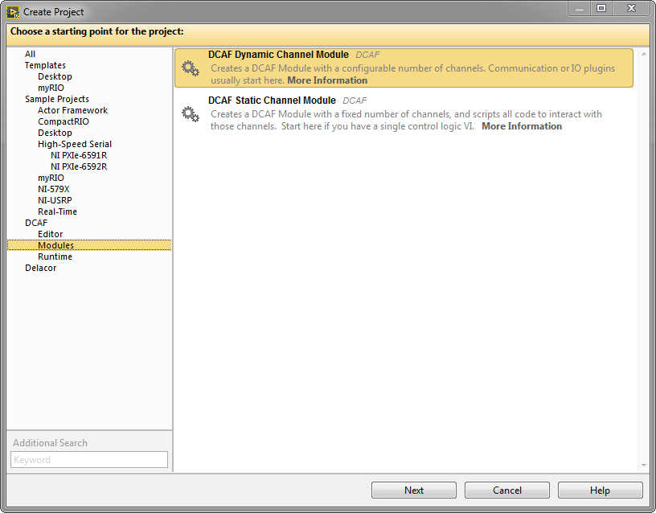
Create New Project From Template

Slide 3
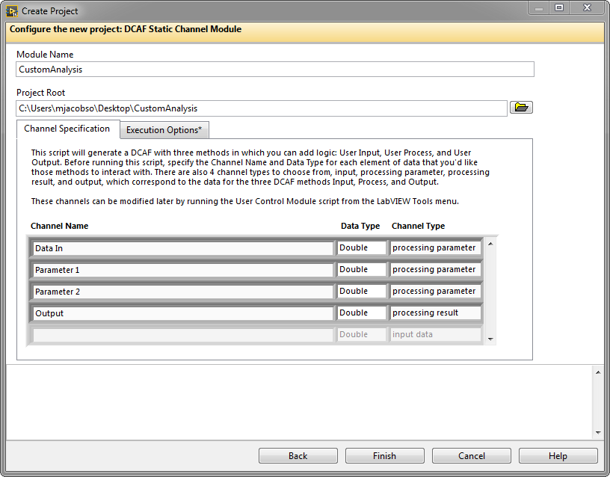
Create New Project From Template

Slide 4
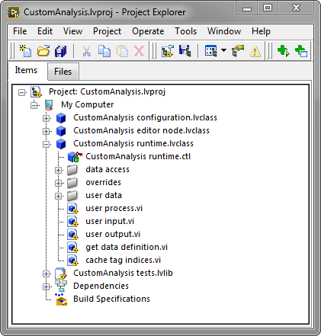
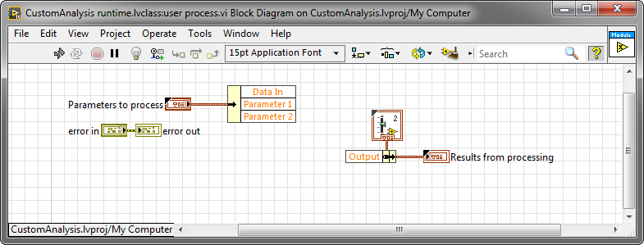
Create New Project From Template

Slide 5
Add Module to Configuration

Slide 6
Creating a Dynamic Module

Slide 7
Create New Project From Template

Slide 8
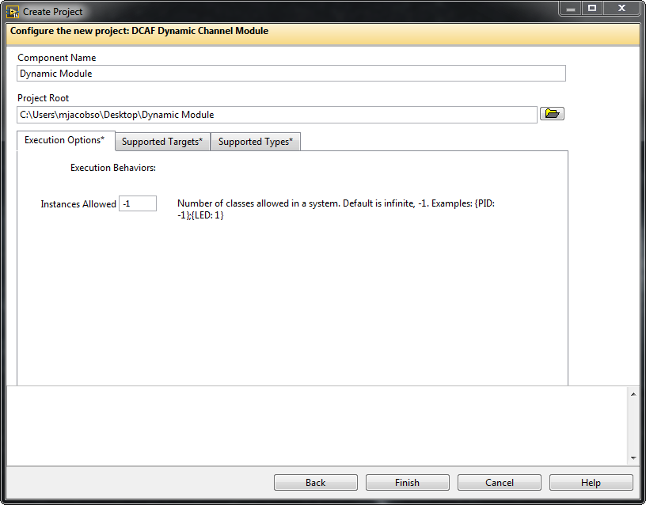
Create New Project From Template

Slide 9
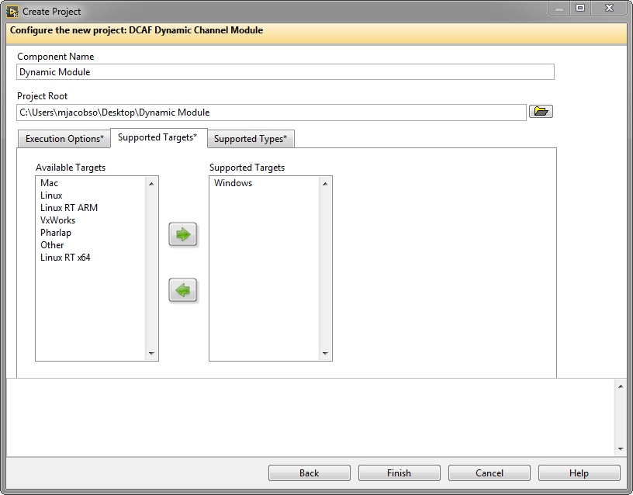
Create New Project From Template

Slide 10
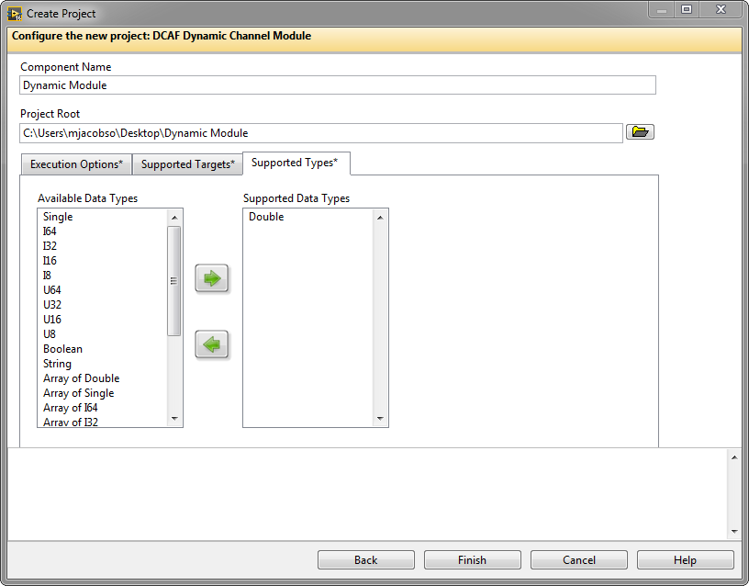
Create New Project From Template

Slide 11
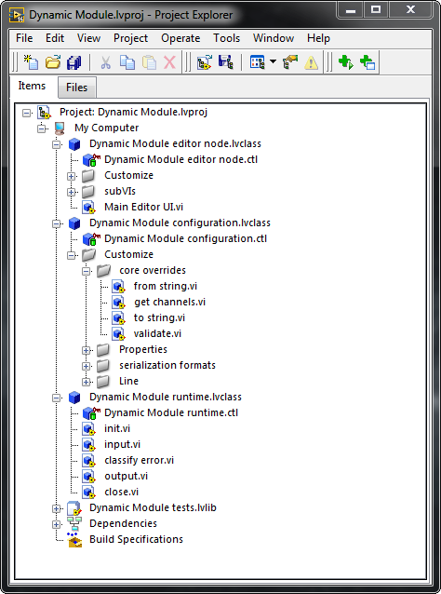
Scripted Project

Slide 12
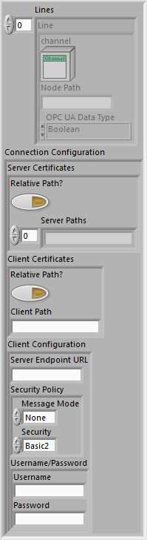
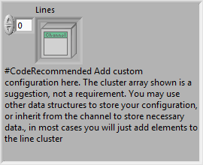
Configuration Class

Slide 13
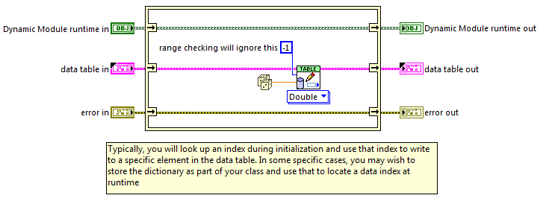
Runtime Class: Input

Slide 14
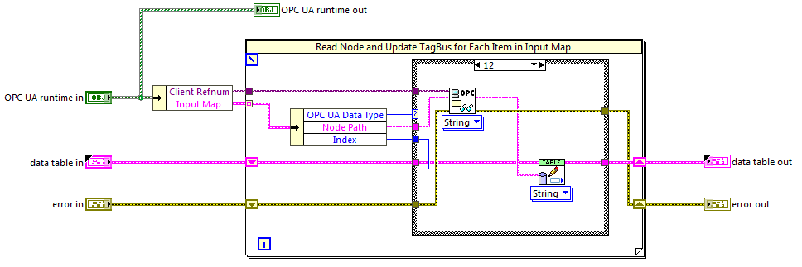
Runtime Class: Input

Slide 15
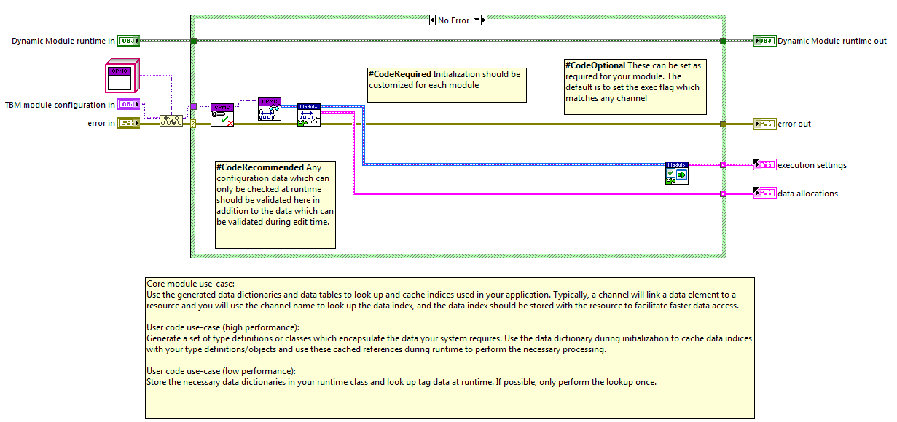
Runtime Class: Init

Slide 16
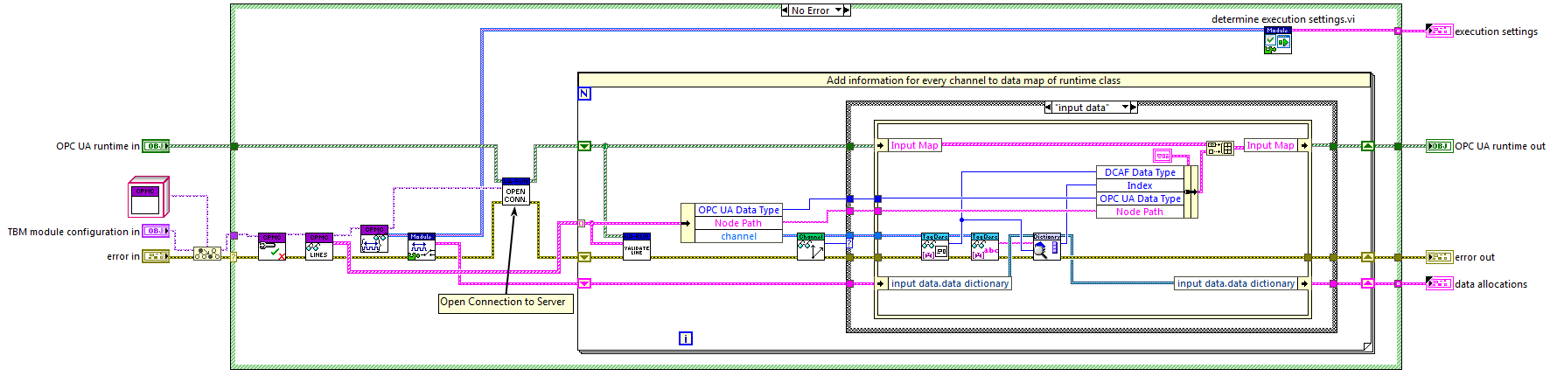
Runtime Class: Init

